Slide 1
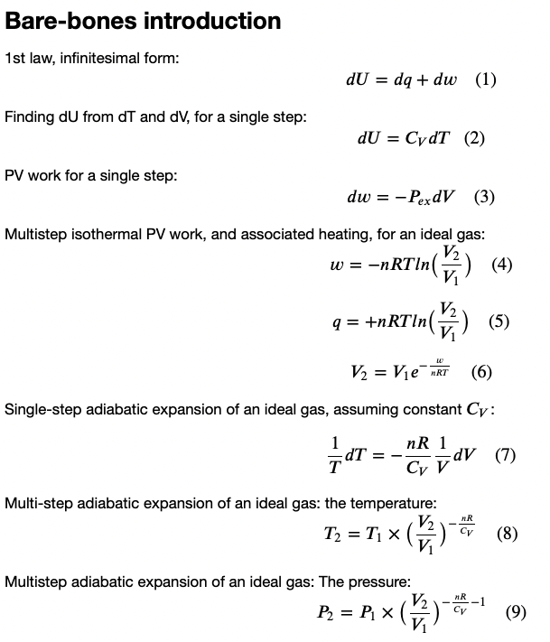
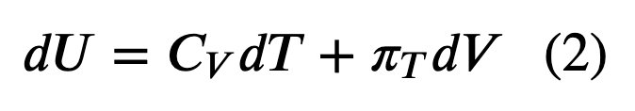
Recap
What we’ve done so far this week
Heat, work, and the 1st Law
Explored how that relates to the behavior of gases as they expand & contract
Constructed Carnot cycles

Slide 2
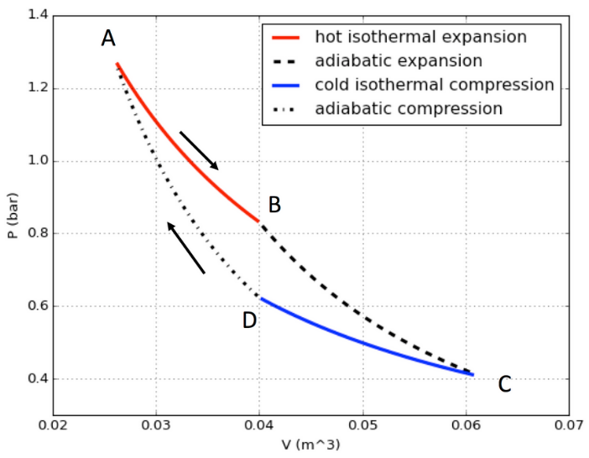


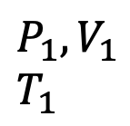







Recap: a Carnot engine is a theoretical heat engine that converts heat into work
$$T_{H}$$
$$P_{ex}$$
$$w_{1}$$
|w_{tot}|
$$P_{ex}$$
$$w_{4}$$
$$w_{2}$$
$$P_{2},V_{2}$$
$$T_{2}$$
$$P_{1},V_{1}$$
$$T_{1}$$
$$w_{3}$$
|Q_{C}|
$$T_{C}$$
The “working fluid” of a Carnot engine is an ideal gas

Slide 3
Recap: real thermoelectric power plants use similar ideas
The “working fluid” is water
$$T_{H}$$
|w_{tot}|
|Q_{C}|
$$T_{C}$$

Slide 4
Let’s draw arrows from the five quantities on the left (T_{H}, etc.) to places on the right.
$$T_{H}$$
|w_{tot}|
|Q_{C}|
$$T_{C}$$

Slide 5
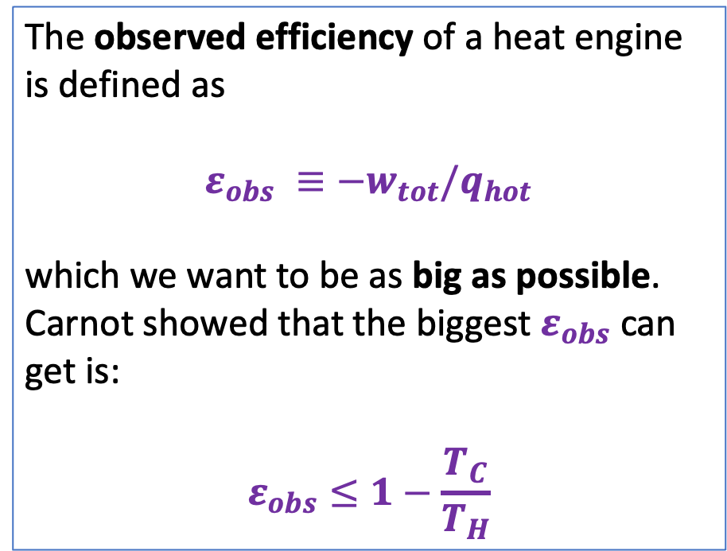
More recap: there’s a theoretical maximum the the efficiency of any real heat engine
$$T_{H}$$
The observed efficiency of a heat engine is defined as
$${ε_{obs} ≡−w}_{tot}/q_{hot}$$
which we want to be as big as possible. Carnot showed that the biggest $ε_{obs}$ can get is:
$$ε_{obs}≤1−\frac{T_{C}}{T_{H}}$$
|w_{tot}|
|Q_{C}|
$$T_{C}$$

Slide 6
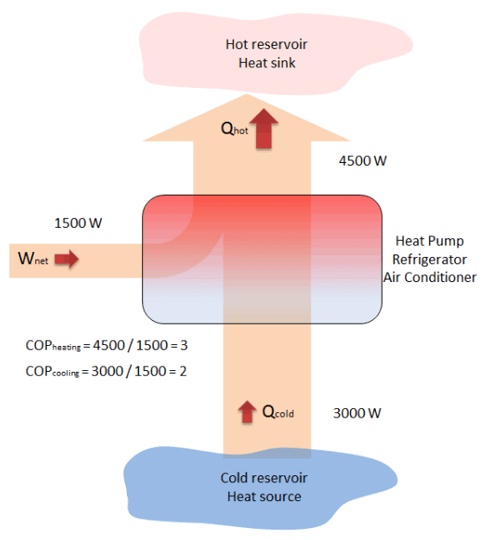


Heat pumps vs heat engines
A heat pump’s job is to use work (electricity) to move heat from a cold place to a warm place.
A heat engine’s job is to convert heat from a hot place (like a furnace) into work (electricity), dumping the waste heat into a cold place (the ocean or something).
Your home
$$T_{H}$$
|w_{tot}|
|w_{tot}|
Outside, on a winter day
$$T_{C}$$
https://www.thermal-engineering.org/what-is-coefficient-of-performance-cop-heat-pump-definition/

Slide 7
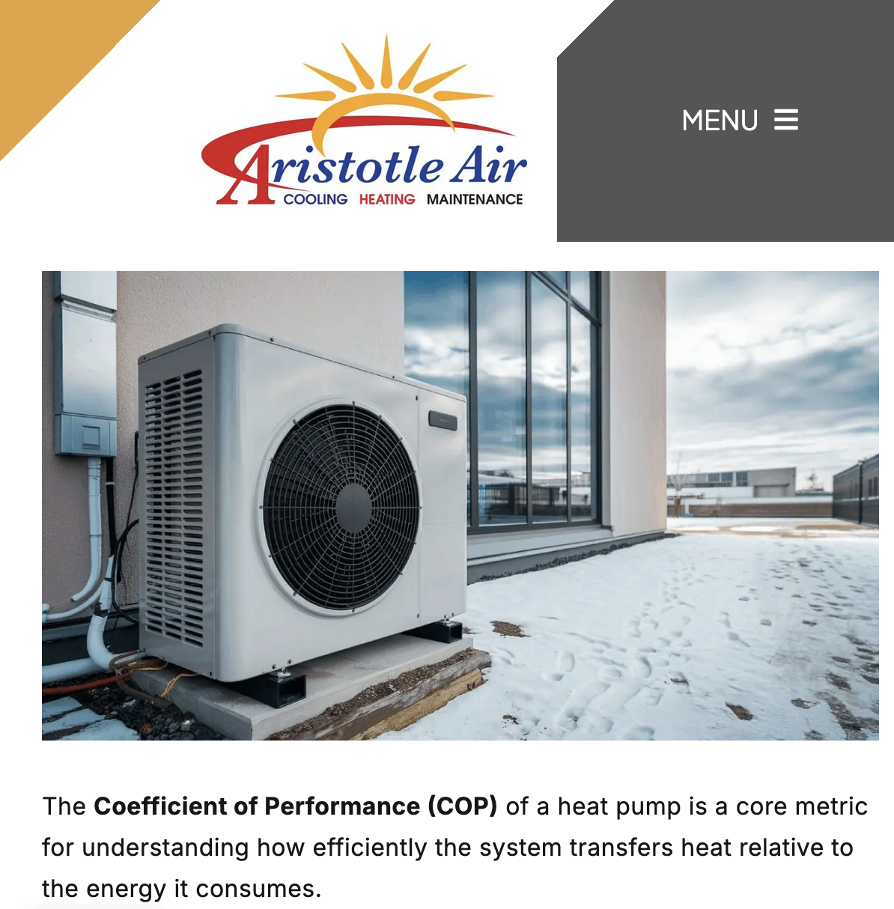
Heat pumps vs heat engines
A heat pump’s job is to use work (electricity) to move heat from a cold place to a warm place.
Your home
|w_{tot}|
Outside, on a winter day
https://www.thermal-engineering.org/what-is-coefficient-of-performance-cop-heat-pump-definition/

Slide 8

Heat pumps when trying to heat your house
Here we’re using a heat pump to warm your house on a cold day.
Notice from this figure that
$$COP_{heating,obs}≡\frac{q_{hot}}{w_{tot}}$$
ought to be greater than 1.
Your home
|w_{tot}|
Outside, on a winter day
https://www.thermal-engineering.org/what-is-coefficient-of-performance-cop-heat-pump-definition/

Slide 9
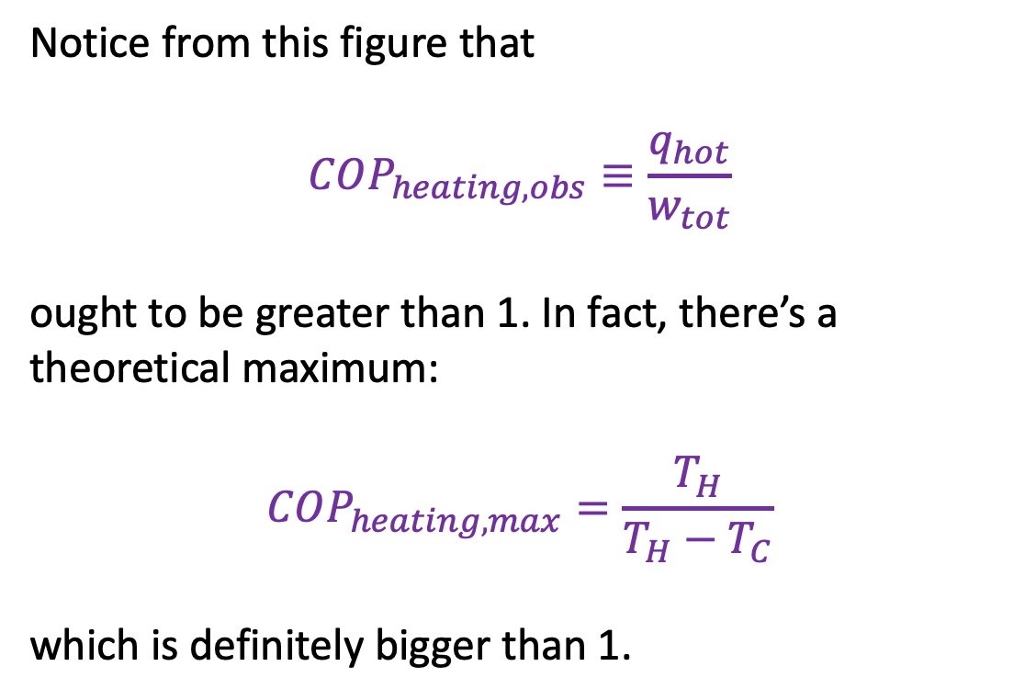
Heat pumps when trying to heat your house
Here we’re using a heat pump to warm your house on a cold day.
Notice from this figure that
$$COP_{heating,obs}≡\frac{q_{hot}}{w_{tot}}$$
ought to be greater than 1. In fact, there’s a theoretical maximum:
$$COP_{heating,max}=\frac{T_{H}}{{T_{H}−T}_{C}}$$
which is definitely bigger than 1.
Your home
|w_{tot}|
Outside, on a winter day
https://www.thermal-engineering.org/what-is-coefficient-of-performance-cop-heat-pump-definition/

Slide 10
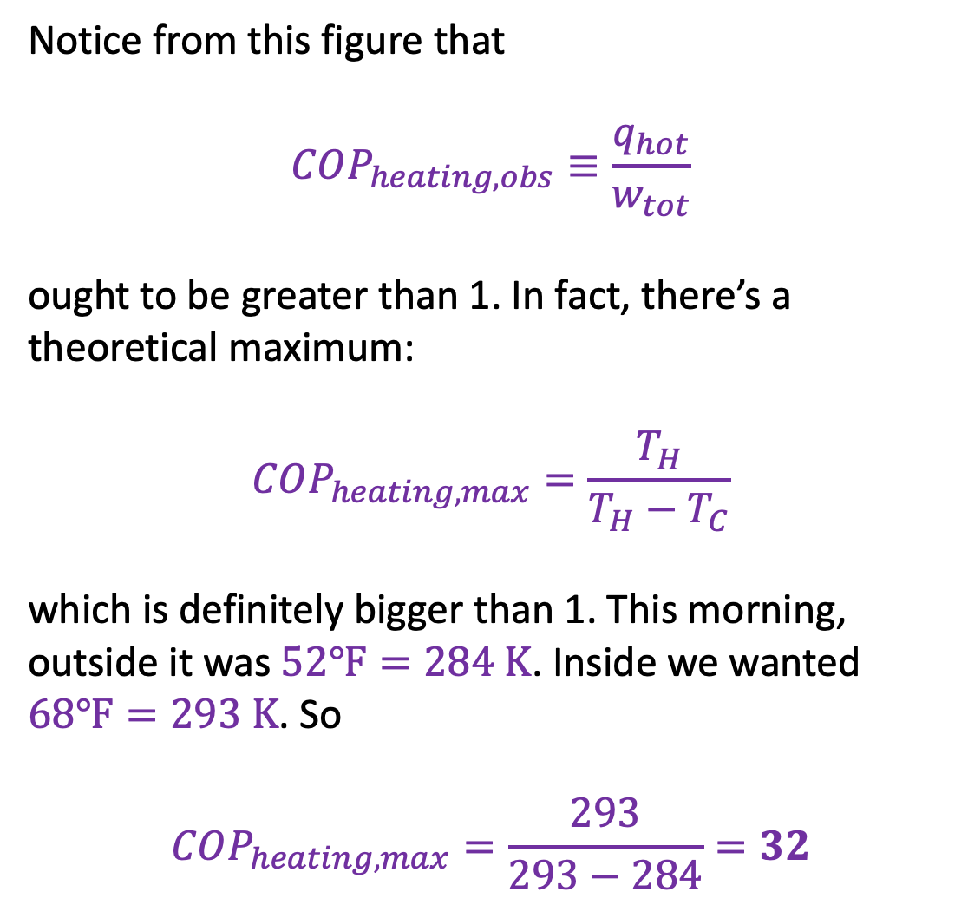
Heat pumps when trying to heat your house
Here we’re using a heat pump to warm your house on a cold day.
Notice from this figure that
$$COP_{heating,obs}≡\frac{q_{hot}}{w_{tot}}$$
ought to be greater than 1. In fact, there’s a theoretical maximum:
$$COP_{heating,max}=\frac{T_{H}}{{T_{H}−T}_{C}}$$
which is definitely bigger than 1. This morning, outside it was $52℉=284 K$. Inside we wanted $68℉=293 K$. So
$$COP_{heating,max}=\frac{293}{293−284}=32$$
Your home
|w_{tot}|
Outside, on a winter day
https://www.thermal-engineering.org/what-is-coefficient-of-performance-cop-heat-pump-definition/

Slide 11

Heat pumps when trying to heat your house
Notice from this figure that
$$COP_{heating,obs}≡\frac{q_{hot}}{w_{tot}}$$
ought to be greater than 1. In fact, there’s a theoretical maximum:
$$COP_{heating,max}=\frac{T_{H}}{{T_{H}−T}_{C}}$$
which is definitely bigger than 1. This morning, outside it was $52℉=284 K$. Inside we wanted $68℉=293 K$. So
$$COP_{heating,max}=\frac{293}{293−284}=32$$

Slide 12
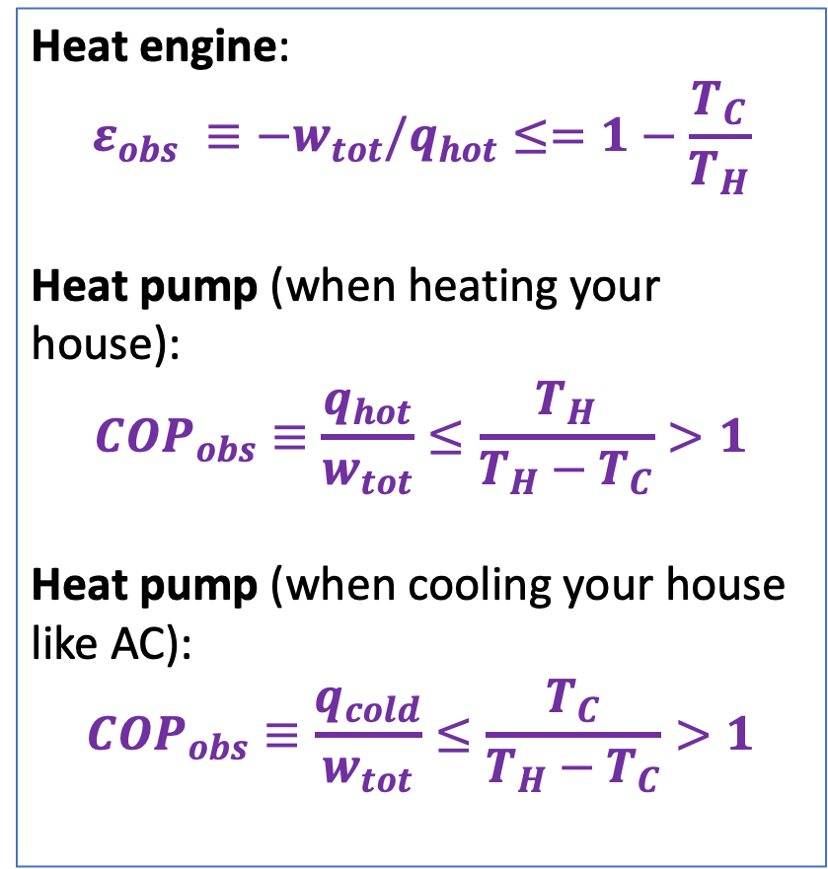
Adding efficiency and “coefficient of performance” (COP) to our list of equations
Heat engine:
$${ε_{obs} ≡−w}_{tot}/q_{hot}≤=1−\frac{T_{C}}{T_{H}}$$
Heat pump (when heating your house):
$$COP_{obs}≡\frac{q_{hot}}{w_{tot}}≤\frac{T_{H}}{{T_{H}−T}_{C}}>1$$
Heat pump (when cooling your house like AC):
$$COP_{obs}≡\frac{q_{cold}}{w_{tot}}≤\frac{T_{C}}{{T_{H}−T}_{C}}>1$$

